Slide 1
Sistemas Distribuídos e Computação Paralela
Glauco Vinicius Scheffel

Slide 2
24h
Introdução. Programação Paralela. Controle de Concorrência. Programação Distribuída. Comunicação entre Processos.

Slide 3
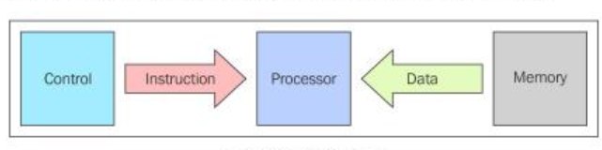
Modelo de Von Newmann

Slide 4
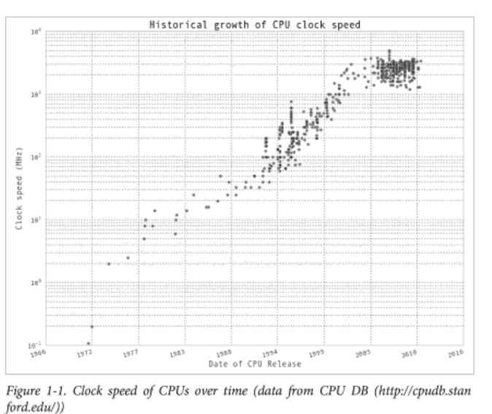

Slide 5
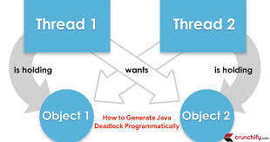
Deadlock

Slide 6
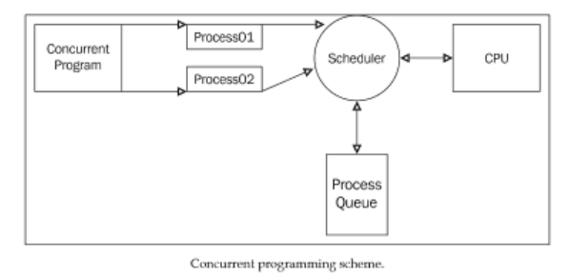
Multi Threading
Notes:
import multiprocessing as mp
import random
import string
random.seed(123)
# Define an output queue
output = mp.Queue()
# define a example function
def rand_string(length, output):
""" Generates a random string of numbers, lower- and uppercase chars. """
rand_str = ''.join(random.choice(
string.ascii_lowercase
+ string.ascii_uppercase
+ string.digits)
for i in range(length))
output.put(rand_str)
# Setup a list of processes that we want to run
processes = [mp.Process(target=rand_string, args=(5, output)) for x in range(4)]
# Run processes
for p in processes:
p.start()
# Exit the completed processes
for p in processes:
p.join()
# Get process results from the output queue
results = [output.get() for p in processes]
print(results)

Slide 7
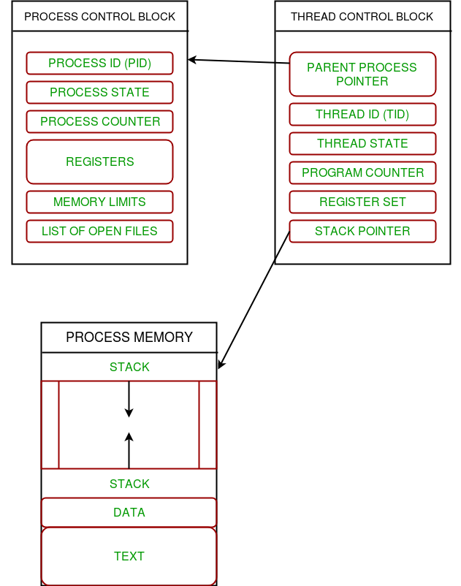
Processos e threads

Slide 8
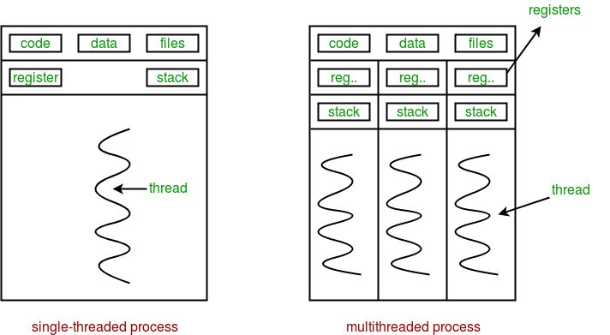
Multithread

Slide 9
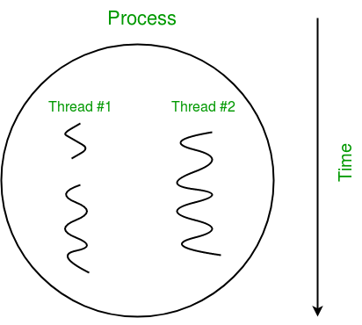
Multithread

Slide 10
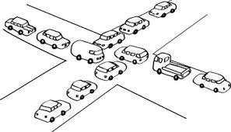
Deadlock

Slide 11

Starvation

Slide 12
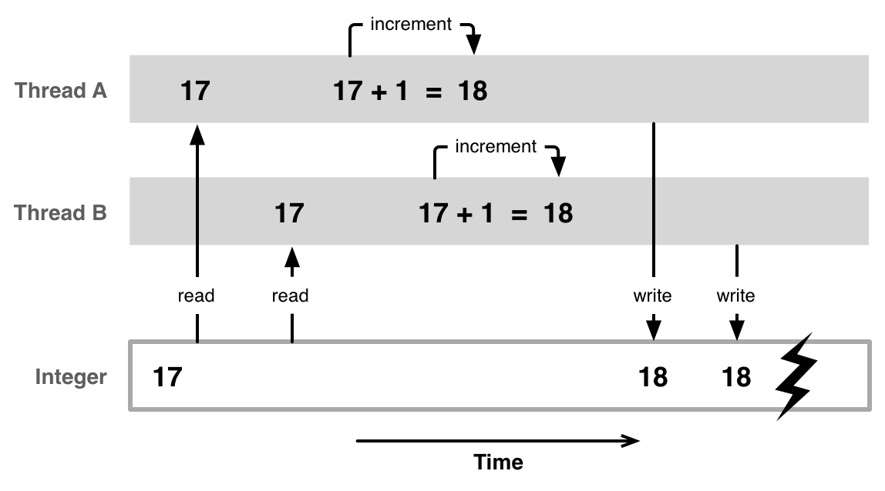
Race condition

Slide 13
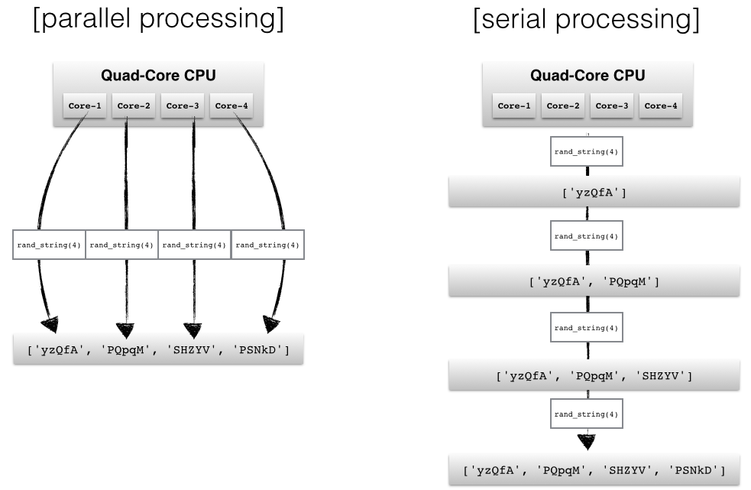
Multi CPU
Notes:
import multiprocessing as mp
import random
import string
random.seed(123)
# Define an output queue
output = mp.Queue()
# define a example function
def rand_string(length, output):
""" Generates a random string of numbers, lower- and uppercase chars. """
rand_str = ''.join(random.choice(
string.ascii_lowercase
+ string.ascii_uppercase
+ string.digits)
for i in range(length))
output.put(rand_str)
# Setup a list of processes that we want to run
processes = [mp.Process(target=rand_string, args=(5, output)) for x in range(4)]
# Run processes
for p in processes:
p.start()
# Exit the completed processes
for p in processes:
p.join()
# Get process results from the output queue
results = [output.get() for p in processes]
print(results)

Slide 14
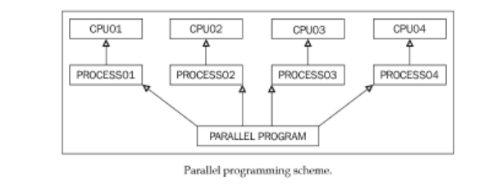
Multi CPU
Notes:
import multiprocessing as mp
import random
import string
random.seed(123)
# Define an output queue
output = mp.Queue()
# define a example function
def rand_string(length, output):
""" Generates a random string of numbers, lower- and uppercase chars. """
rand_str = ''.join(random.choice(
string.ascii_lowercase
+ string.ascii_uppercase
+ string.digits)
for i in range(length))
output.put(rand_str)
# Setup a list of processes that we want to run
processes = [mp.Process(target=rand_string, args=(5, output)) for x in range(4)]
# Run processes
for p in processes:
p.start()
# Exit the completed processes
for p in processes:
p.join()
# Get process results from the output queue
results = [output.get() for p in processes]
print(results)

Slide 15
Multiprocessing
from multiprocessing import Pool
def f(x):
return x*x
if __name__ == '__main__':
with Pool(5) as p:
print(p.map(f, [1, 2, 3]))

Slide 16
Queue
from multiprocessing import Process, Queue
def f(q):
q.put([42, None, 'hello'])
if __name__ == '__main__':
q = Queue()
p = Process(target=f, args=(q,))
p.start()
print( q.get() )
p.join()

Slide 17
Pipe
from multiprocessing import Process, Pipe
def f(conn):
conn.send([42, None, 'hello'])
conn.close()
if __name__ == '__main__':
parent_conn, child_conn = Pipe()
p = Process(target=f, args=(child_conn,))
p.start()
print parent_conn.recv() # prints "[42, None, 'hello']"
p.join()
Notes:
data in a pipe may become corrupted if two processes (or threads) try to read from or write to the same end of the pipe at the same time

Slide 18
Bloqueio
from multiprocessing import Process, Lock
def f(l, i):
l.acquire()
try:
print('hello world', i)
finally:
l.release()

Slide 19
Bloqueio
if __name__ == '__main__':
lock = Lock()
for num in range(10):
Process(target=f, args=(lock, num)).start()

Slide 20
Shared Memory
from multiprocessing import Process, Value, Array
def f(n, a):
n.value = 3.1415927
for i in range(len(a)):
a[i] = -a[i]

Slide 21
Shared Memory
if __name__ == '__main__':
num = Value('d', 0.0)
arr = Array('i', range(10))
p = Process(target=f, args=(num, arr))
p.start()
p.join()
print(num.value)
print(arr[:])

Slide 22
https://www.geeksforgeeks.org/multithreading-python-set-1/

